Slide 1

New York State Conservation Council
Spring Meeting, 2023
Stephen S. Hurst
Chief, Bureau of Fisheries
April 1, 2023

Slide 2
New York State Conservation Council
Spring Meeting, 2023
Scriba Creek – Oneida Walleye Run
Water Chestnut Mitigation – Region 7
Trout Stream Access Verification
Big Panfish Initiative Update – Concerns with growth
Lake Erie Walleye Minimum Size Limit
Lake Ontario Sea Lamprey
Will DEC stock wipers (white bass/striped bass hybrids)?

Slide 3
Scriba Creek
Barriers placed roadside
Fishing prohibited for all persons March 16 – April 30

Slide 4
Water Chestnut Mitigation in Region 7
Widespread issue in Region 7 (esp. canal system)
SWCDs - Pursuing active mitigation along Three-Rivers corridor
Onondaga SWCD removed ~5 million lbs from Cross Lake and Seneca River in 2022.
DEC - Mechanical harvester for Montezuma and Seneca River
Hand-pulling events occur throughout the region
R7 DEC AIS Strike Team – early detection

Slide 5
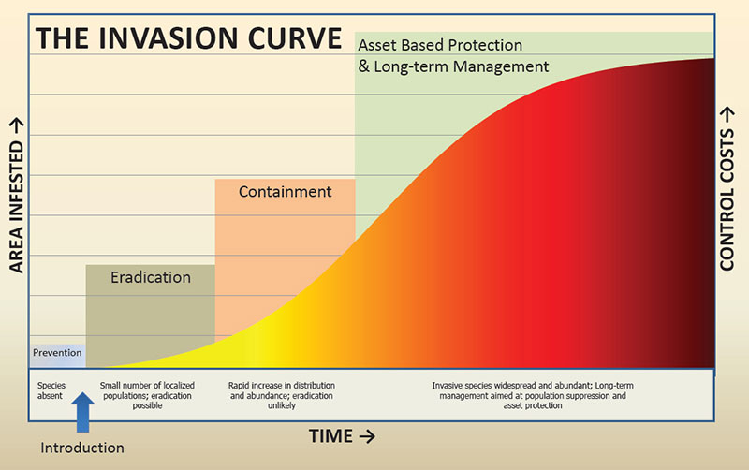
Water Chestnut Mitigation in Region 7

Slide 6
Trout Stream Access Verification
Background
DEC stocks
952,000 trout into,
2,000 miles of trout streams annually (~4,000 bank miles) of which,
1,470 bank miles are verified publicly accessible
2,530 bank miles are unverified regarding public access

Slide 7
Trout Stream Access Verification
63% of the trout stream bank mileage we stock is on private lands without any type of agreement for access

Slide 8
Trout Stream Access Verification
Measure | Access Verification
 | Publicly Accessible | Unknown Access | Total
Tax Parcels | 5,898 (26%) | 17,103 (74%) | 23,001
Bank Mileage | 1,470 (27%) | 2,537 (63%) | 4,007

Slide 9
Trout Stream Access Verification
Why is this a problem?
Anglers need to know where they can and cannot fish for stocked trout
Stocking fish in waters flowing through unposted / unmapped property may negatively affect landowners

Slide 10
Trout Stream Access Verification
Why is this a problem?
We have the responsibility to stock trout where all anglers have an equal opportunity to pursue them
Responsible use of the peoples money
You can’t manage what you can’t measure

Slide 11
Trout Stream Access Verification
What we’re doing
Verifying access on all stocked stream reaches
Pilot program in 2022
8 counties

Slide 12
Trout Stream Access Verification
Region | Year 1 Counties for Access Verification | Pre verification mileage | % of each Region’s Total Stocked* Mileage in Year 1 Counties
3 | Putnam | 26.0 | 7.9%
4 | Montgomery & Schenectady | 9.6 | 1.9%
5 | Franklin | 78.8 | 20.5%
6 | Saint Lawrence | 65.3 | 18.4%
7 | Tioga | 28.7 | 13.2%
8 | Steuben | 54.5 | 37.1%
9 | Erie | 36.0 | 8.3%

Slide 13
Trout Stream Access Verification
Process
Verification letters sent to landowners who own parcels:
  At bridge crossings
  Where reach runs close to a road
Follow up letters sent to adjacent landowners
Reaches assessed based on responses

Slide 14
Trout Stream Access Verification
Process
If access is not gained at bridge crossing or road RFM must adjust stocking
If access is gained at bridge crossing or road RFM has a choice
  Contact adjacent landowners or,
  Implement a new Road Access Stocking Policy (RAS)

Slide 15
Trout Stream Access Verification
What’s a RAS (road access stocking)
RAS policies will provide the public some opportunities to fish on short sections of stream deemed publicly accessible.
Used on streams where we did not receive a positive response from landowners adjacent to lands where we were permitted access.

Slide 16
Trout Stream Access Verification
What’s a RAS (road access stocking)
Point stocking vs a calculation based on area
Allow for the stocking of a limited number of trout (instead of none)
Provide for short-term, put-and-take fisheries within short sections of stream posted as “Fishing Permitted.”
“Stocked” Category only

Slide 17
Trout Stream Access Verification – RAS cont.
RAS Category | Minimum Criteria | Stocking Rate
Default | 50 feet contiguous access to a pool for bridge crossings, or 150 feet contiguous access to a pool for roadside parcels; and Access to a pool with a minimum of 750 square feet, have an average water depth of 3’ or greater. | 75 yearlings 8 12” trout
High | 100 feet contiguous access for bridge crossings 300 feet contiguous access for roadside parcels The pool must have a minimum of 1,500 square feet, have an average water depth of 3’ or greater. | 150 yearlings 15 12” trout

Slide 18
Trout Stream Access Verification
Outcome (year 1)
Parcel Outcome | Number of Parcels | % of Parcels
Verified Access | 168 | 21%
Access Denied | 202 | 25%
Unable to Contact | 334 | 42%
In Process | 92 | 12%
 | 796 | 100%

Slide 19
Trout Stream Access Verification
Outcome (year 1)
168 parcels allowed access
42.7 miles of bank access verified
14 Stocked reaches unchanged
11 Stocked reaches dropped

Slide 20
Trout Stream Access Verification
Outcome (year 1)
30 Stocked reaches shortened or split
Stocked reach mileage reduced by 134.9 miles (45.1%)
19 RAS Policies Created

Slide 21
Trout Stream Access Verification
Outcome (year 1)
Pre verification trout: 82,151
Post verification trout: 52,788
Reduction in stocked trout: 29,363 (35.7%)

Slide 22
Trout Stream Access Verification
Next steps
Build a GIS to track access
Update Info-locator Interactive Trout Stream Maps
Update trout streams in HuntFishNY Tackle Box App

Slide 23
Trout Stream Access Verification
Next steps - 2023
Region | 2023 Counties (21) for Access Verification | Pre verification mileage* | % of each Region’s Total Stocked* Mileage
3 | Dutchess, Rockland, Westchester | 127.8 | 40.9%
4 | Columbia, Rensselaer, Otsego | 116.3 | 40.5%
5 | Fulton, Hamilton, Saratoga | 110.2 | 30.1%
6 | Herkimer, Jefferson | 120.9 | 34.0%
7 | Broome, Cayuga, Chenango, Cortland, Oswego | 96.7 | 30.6%
8 | Chemung, Schuyler, Seneca, Yates | 35.6 | 29.1%
9 | Chautauqua | 26.5 | 10.1%

Slide 24
Big Panfish Initiative Update
Sunfish Sampling
11 waters in 2021
Approximately 4,500 sunfish were collected
The growth rate objective (8 inches by age 5) was met for most populations
No sunfish population met all size structure objectives (PSD-70, RSD8-30, RSD10-5).

Slide 25
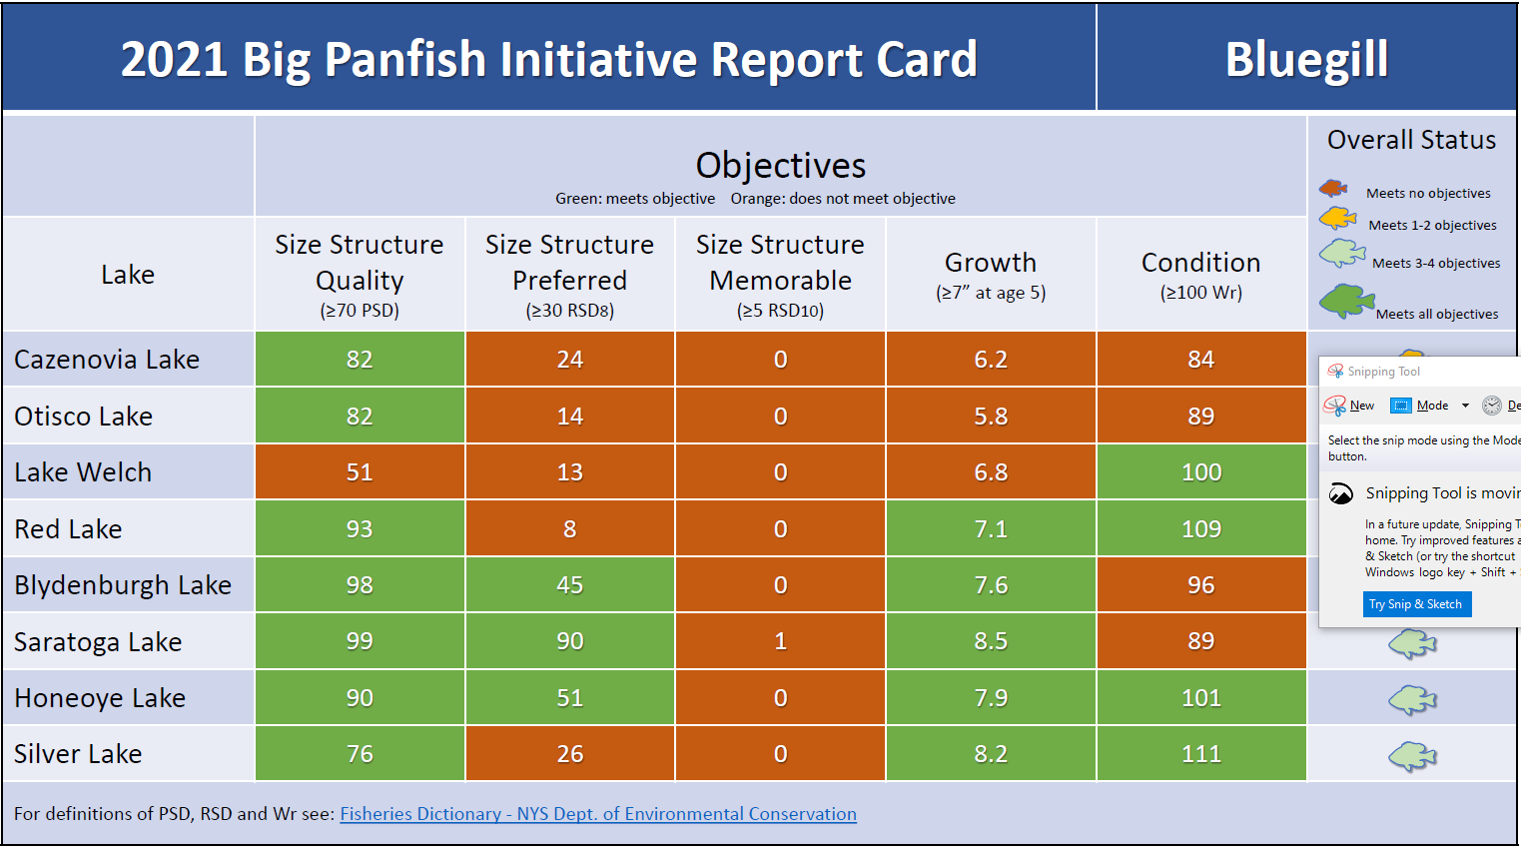

Slide 26
Big Panfish Initiative Update
Crappie Sampling
9 waters in 2021
3,157 crappie were collected.
The size structure objectives (PSD-60, RSD10-20) were met in 5 waters.
The growth objective (10 inches at age 4) was only met for white crappie in Otisco Lake.

Slide 27
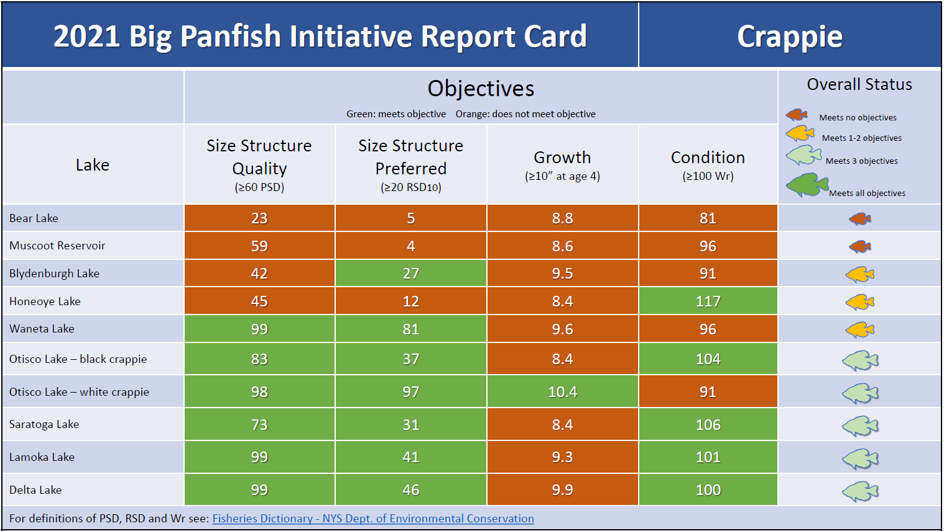

Slide 28
Big Panfish Initiative Update
Next Steps
Compile and assess 2022 sampling data
Conduct 2023 sampling this April and May
Continue annual monitoring through 2025

Slide 29
Lake Erie Walleye MSL
Issue: Many fish under the minimum size limit that are released offshore die due to barotrauma
Offshore anglers are concerned about wasted fish
Anglers are also concerned about nearshore stock depletion
56 % of anglers surveyed were in favor of lowering the MSL
Subsequent meetings with anglers revealed that many who opposed the change were mis-informed and thought that they would be required to keep small fish
Despite majority support there was vocal opposition
DEC will not move forward with a reduction in the size limit

Slide 30
Lake Ontario Sea Lamprey
High numbers of sea lamprey in Lake Ontario in 2022.
Several sea lamprey control treatments were missed in 2020 and 2021.
DEC, DFO and USFWS treated four highest priority tributaries in New York in 2021. Trout Brook, Little Sandy Creek, Salmon River, and Grindstone Creek
9 tributaries scheduled for treatment in 2020 or 2021 were not treated.

Slide 31
Lake Ontario Sea Lamprey
DFO successfully conducted treatments on nine tributaries in 2022: Little Salmon River, Lindsey Creek, South Sandy Creek, Snake Creek, Catfish Creek, Eightmile Creek, Ninemile Creek, Sterling Creek, and Black River.
DFO plans to treat seven Lake Ontario tributaries in New York in 2023: Trout Brook, Salmon River, Little Salmon River, Little Sandy Creek, Grindstone Creek, Black River, Fish Creek.

Slide 32
Lake Ontario Sea Lamprey
Sea lamprey will remain high in 2023, lower than 2022
Numbers will continue to decline and return to normal levels as treatments are now back on schedule

Slide 33
Lake Ontario Sea Lamprey
.

Slide 34
Lake Ontario Sea Lamprey
.

Slide 35
Will DEC Stock Wipers
Nope

Slide 36
Back pocket slides for questions

Slide 37
Stocking Category | Number of Tax Parcels
 | Publicly Accessible | Unknown Access | Total
Stocked | 3,598 | 13,442 (79%) | 17,040
Stocked-Extended | 2,300 | 3,661 (61%) | 5,961
Stocking Category | Bank Mileage
 | Publicly Accessible Bank Mileage | Unknown Access Bank Mileage | Total Reach Miles*
Stocked | 962.9 | 2,110.9 | 1,536.9
Stocked-Extended | 506.5 | 425.9 | 466.2
*Available bank mileage is assumed to be double the total reach miles

Slide 38

Process
8 Counties to be Verified in 2022
Region | Total Stocked* Reach Mileage in Region | Year 1 Counties for Access Verification | Percentage of each Region’s Total Stocked* Mileage in Year 1 Counties
3 | 312.1 | Putnam | 7.9%
4 | 287.4 | Montgomery & Schenectady | 1.9%
5 | 366.1 | Franklin | 20.5%
6 | 355.5 | Saint Lawrence | 18.4%
7 | 210 | Tioga | 13.2%
8 | 122.2 | Steuben | 37.1%
9 | 261.9 | Erie | 8.3%

Slide 39
Process
RAS Category | Minimum Criteria | Stocking Rate
Default | 50 feet contiguous access to a pool for bridge crossings, or 150 feet contiguous access to a pool for roadside parcels; and Access to a pool with a minimum of 750 square feet, have an average water depth of 3’ or greater. | 75 yearlings 8 12” trout
High | 100 feet contiguous access for bridge crossings 300 feet contiguous access for roadside parcels The pool must have a minimum of 1,500 square feet, have an average water depth of 3’ or greater. | 150 yearlings 15 12” trout

Slide 40
2022 Regional summary of stocked reaches
Region | Pre-Verification Mileage | Post-Verification Mileage | Miles Lost | % Mileage Lost | Pre-Verification Trout | Post-Verification Trout | Trout Diff | % Trout Diff | New RAS Points
3 | 19.87 | 1.08 | 18.79 | 94.5% | 4,736 | 1,091 | 3,645 | 77.0% | 2
4 | 9.61 | 3.77 | 5.84 | 60.7% | 1,359 | 1,270 | 89 | 6.5% | 2
5 | 63.98 | 43.19 | 20.79 | 32.5% | 22,930 | 18,148 | 4,782 | 20.9% | 0
6 | 65.26 | 21.30 | 43.95 | 67.4% | 30,005 | 13,527 | 16,478 | 54.9% | 6
7 | 28.73 | 18.90 | 9.83 | 34.2% | 9,230 | 9,147 | 83 | 0.9% | 1
8 | 30.43 | 7.97 | 22.46 | 73.8% | 6,034 | 2,408 | 3,626 | 60.1% | 1
9 | 21.51 | 8.25 | 13.26 | 61.7% | 7,857 | 7,197 | 660 | 8.4% | 7
Totals | 239.38 | 104.47 | 134.91 | 56.4% | 82,151 | 52,788 | 29,363 | 35.7% | 19

Slide 42
Proposed Timeline
Date | Action
June 1 | Letters of inquiry and Regional direct contacts begin.
June 29 | 2nd round of letters of inquiry sent.
July 27 | 3rd round of letters of inquiry sent.
Oct. 15 | Descriptions of finalized stocked reaches and RASs completed, including calculating the numbers of fish to be stocked in each.
March 15 | DECinfo Locator and Tackle Box App updated with verified access and stocking information.
March 31 | Verified access sites are posted with fishing permitted signs.

Slide 43
Lessons Learned
Landowner letters were successful at making contact
Most landowners responded within 21 days (92% of “interested” landowners)
Railroads do not provide access
Towns often had to pass a resolution to enter into a cooperative agreement, so it takes extra time
Municipalities do not always grant access
Need to start earlier to give time to adjust stocking book, include in 2023 reg package, and map revised reaches and access polygons.

Slide 44
Process for 2023
Similar process for 2023
Increase use of landowner letters
Fewer regional direct contacts; limit to just municipalities
continue to pursue major landowners (Niagara-Mohawk, National Grid, etc.)
Involve Hatchery Managers in reach discussions

Slide 45
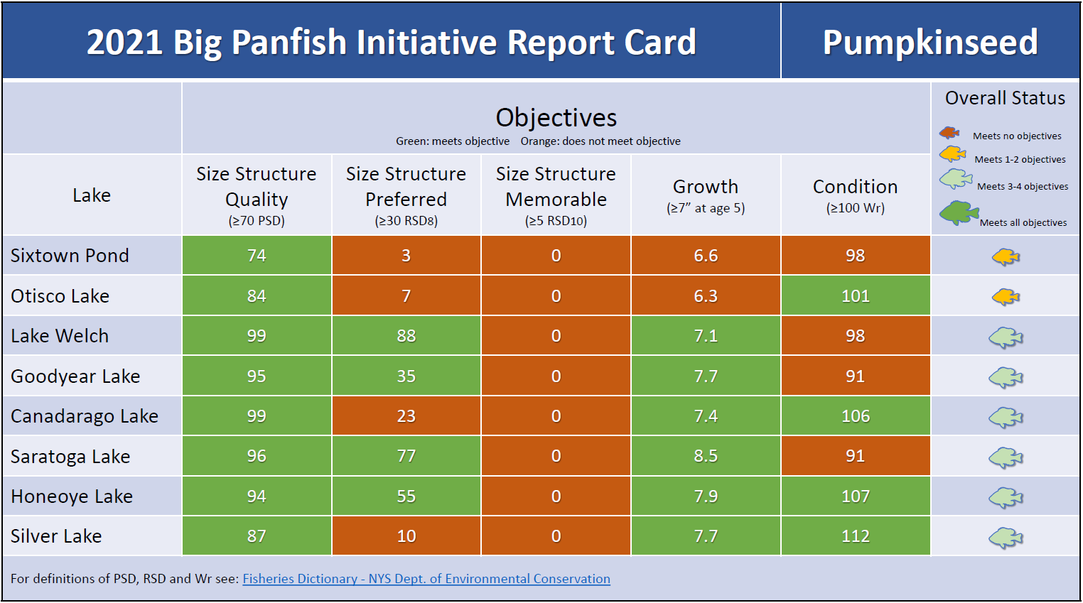

Slide 46
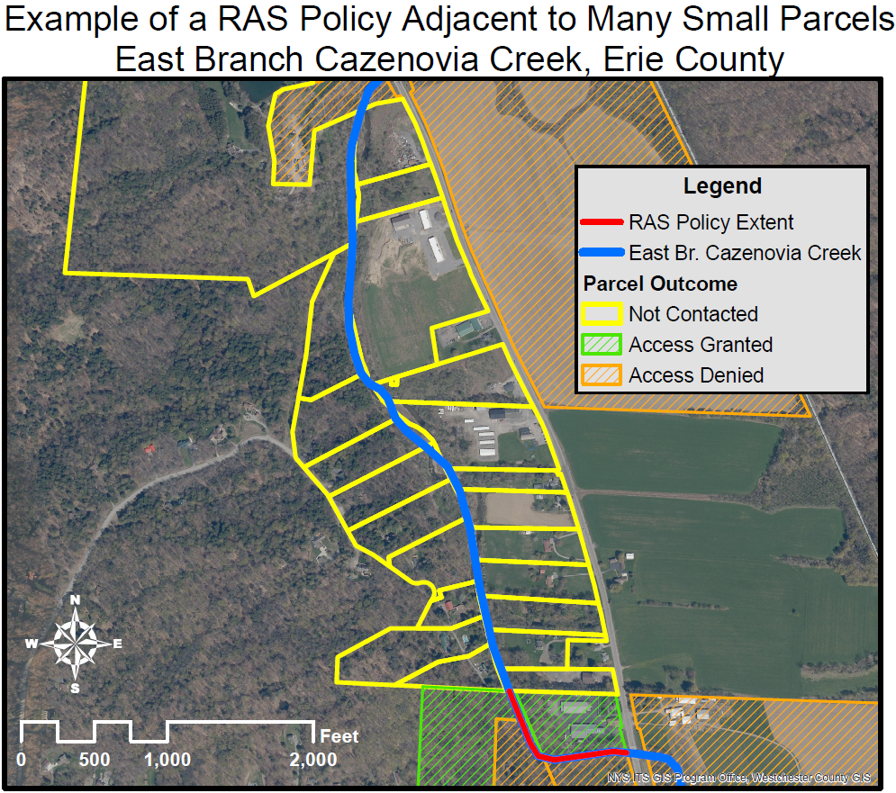

Slide 47
